Slide 1
Unit Four
Chemical Bonding and Structure

Slide 2
Chemical Bonding
Bonding is the joining of at least two atoms to form a molecule or compound.
The electrons found in valence shell are the active portion of an atom during bonding.
A chemical bond is a mutual electrical attraction between the nuclei and valence electrons of different atoms that binds the atoms together.
Chemical bonding is formed by the interaction of outer most electron between atoms.
A+ B →A-B

Slide 3
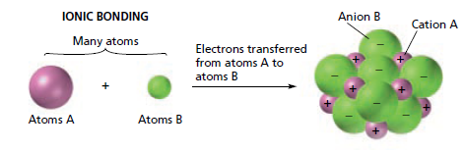
Types of Chemical Bonding
When atoms bond, their valence electrons are redistributed in ways that make the atoms more stable.
The way in which the electrons are redistributed determines the type of bonding.
Ionic Bond
Type of chemical bond that results from the electrostatic force of attraction between two oppositely charged ions.
It is formed due to transfer of electrons from one atom to another by losing and gaining of electrons.

Slide 4
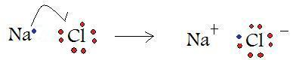
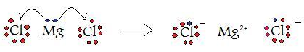
Ionic Bond
The atom that loses electrons will form a cation and the atom that gains electrons will form an anion.
These oppositely charged ions come closer to each other due to electrostatic force of attraction and thus form an ionic bond.
In general, an ionic bond is formed between two atoms that contain greater electronegativity difference.
Most of the time this bond is formed between a metal atom and a nonmetal atom. E.g. NaCl, LiF, MgCl₂

Slide 5
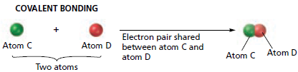
Covalent Bond
A kind of chemical bond formed between two atoms due to sharing of electron pair(s) between the atoms.
It is formed between two atoms that contain the same or small difference in electronegativity.
Bonding between two atoms of the same element is completely covalent.
In covalent bond, single (-), double (=) and triple (≡), quadruple bonds are formed.

Slide 6
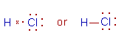
Covalent bond
Covalent bond includes:
polar,
non-polar and
coordinate
Polar covalent bond
covalent bond in which the bonded atoms have an unequal attraction for the shared electrons. E.g. H^{δ+}-Cl^{δ⁻} bond

Slide 7
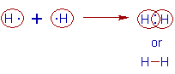
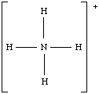
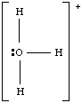
Non-polar covalent bond
covalent bond in which the bonding electrons are shared equally by the bonded atoms, resulting in a balanced distribution of electrical charge.
Coordinate Covalent bond (Dative bond)
Covalent bond that is formed when one atom donates both of the electrons to form a single covalent bond.
The electrons originate from the donor atom as an unshared pair. E.g. NH₄⁺ and HO₃⁺
or

Slide 8
Covalent bonding Theories
Lewis Structure
An American chemist named Gilbert N. Lewis developed the Lewis bonding theory in which electrons are represented as dots called Lewis structures or Lewis electron-dot formulas.
Today we use Lewis structures to determine how atoms are arranged in a molecule and to predict the 3D shape of molecules.
Knowing the shape of a molecule allows us to explain the observed properties and behavior of these substances.
Nonmetal atoms form bonds to achieve a Noble Gas electron configuration.

Slide 9
Lewis Structure
They simply share the electrons in a covalent bond instead of taking electrons away from one another to form ions.
According to Lewis a covalent bond defined as an interaction of two atoms which are held together by a pair of electrons located between the two atoms.
The following generalizations are helpful in constructing Lewis structures:
Count the total number of valence electrons present in the atoms.
The least electronegative atom in a molecule is often located in the central position and the more electronegative atoms occupy the outer (terminal) positions.

Slide 10
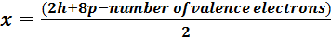
Lewis Structure
Connect all atoms by drawing single bonds between all atoms, then distribute the remaining valence electrons as lone pairs around outer atoms and around the central atom so each has an octet.
If there are not enough electrons for each atom to have an octet, make double or triple bonds between central atom and surrounding atoms.
The number of bonds x in a main-group compound other than H₂ is predicted as:
Where h is the number of hydrogen atoms, and p is the number of p-block atoms. The 2h+ 8p is the maximum total number of electrons they can have in their valence orbitals.

Slide 11
Lewis Structure: Examples
Example 1: F₂
The resulting molecule, written as F-F, demonstrates an important point. It has six pairs of electrons which are not shared by the atoms. Such pairs of electrons are called lone pairs.
Example 2: O₂
Oxygen needs two electrons to attain the octet structure. This places two shared pairs between the two oxygen nuclei. Two pairs of electrons between two atoms constitute two bonds, that is, a double bond. The bond order in the molecule is 2 and O₂is written as O=O
x = (2 x 8 -14)/2 = 1 bond
x=(2 x 8 -12)/2 = 2 bonds

Slide 12
Lewis Structure :Limitations
Lewis theory was good for s-block and p-block elements but not for d-block elements.
Except in simple cases, a Lewis structure cannot predict neither the 3D shape of the species (bond angles) nor the relative internuclear distances (bond lengths).
Lewis theory cannot write one correct structure for many molecules where resonance is important.
Lewis theory often does not predict the correct magnetic behavior of molecules. Oxygen, O₂, is paramagnetic, though the Lewis structure predicts it is diamagnetic.
Exercise: Draw the Lewis structure and find the bonds of the following compounds.ClO₄⁻, SO₃, NO₂⁻.

Slide 13
Sidg wick-Powell theory
The structures of molecules are reviewed by Sidgwick and Powell in 1940.
They suggested that for molecules and ions that only contain single bonds, the approximate shape can be predicted from
the number of electron pairs in the outer or valence shell of the central atom.
Repulsion is minimized if the electron pairs are orientated in space as far apart as possible.

Slide 14
Sidg wick-Powell theory
1) If there are two pairs of electrons in the valence shell of the central atom, the orbitals containing them will be oriented at 180⁰ to each other. It fallows these orbitals overlap with orbitals from other atoms to form bonds, then the molecule formed will be linear.
2) If there are three electrons pairs on the central atom, they will be at 120⁰ to each other, giving a plane triangular structure.
3) For four electron pair is 109⁰28’and the shape is tetrahedral.
4) For five pairs, the shape is a trigonal bipyramid
5) For six pairs the angles are 90⁰ and the shape is octahedral.

Slide 15
Valence shell electron pair repulsion theory (VSEPR)
This theory provides a method for predicting the shape of molecules, based on the electron pair electrostatic repulsion.
It was described by Sidgwick and Powell in 1940 and further developed by Gillespie and Nyholm in 1957.
The VSEPR method predicts shapes that compare favorably with those determined experimentally.
Electrons repel each other because they are negatively charged.
The quantum mechanical rules force some of them to be fairly close to each other in bonding pairs or lone pairs, but each pair repels all other pairs.
The repulsion force between the lone pairs and bond pairs follows this order:
Lone pair - Lone pair > Lone Pair - Bond pair > Bond pair - Bond pair.

Slide 16
VSEPR theory
According to the VSEPR model, molecules adopt geometries in which their valence electron pairs position themselves as far from each other as possible.
A molecule can be described by the generic formula AX_{m}E_{n},,
where A is the central atom, X stands for any atom or group of atoms surrounding the central atom, and E represents a lone pair of electrons.
The steric number (SN = m + n) is the number of positions occupied by atoms or lone pairs around a central atom;
lone pairs and bonds are nearly equal in their influence on molecular shape.

Slide 17
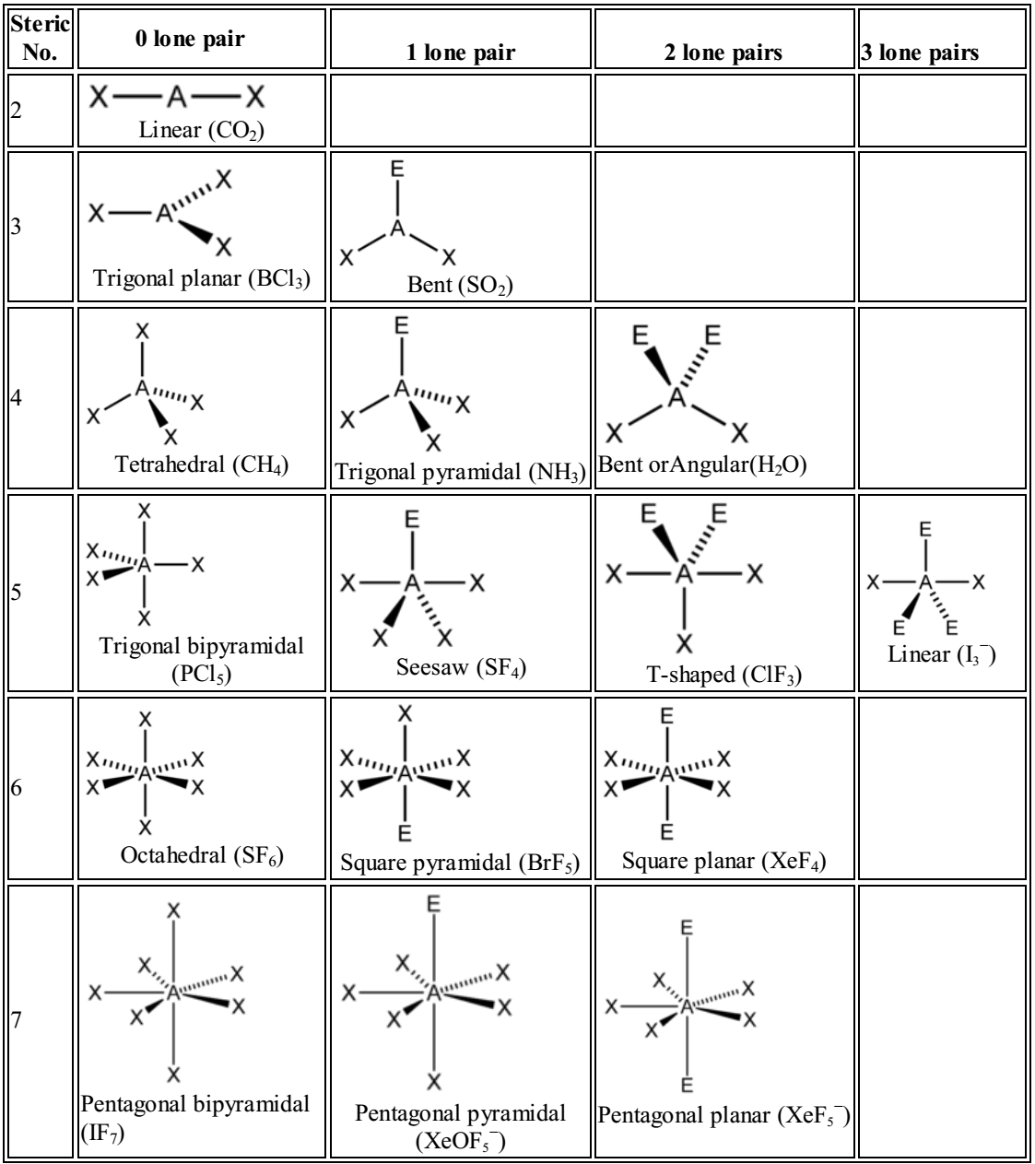

Slide 18
VSEPR Theory: How it works
1.Draw the Lewis structure.
2. Modify the Lewis structure by assigning all atoms or groups bonded to the central atom as single (-), double(=), or triple (≡) bonds.
3.Determine the number of valence electrons in the central atom.
4. Count all σ-bonds around the central atom and the molecular geometry is dictated by σ-bond electron pairs.
When the valence shell of central atom contains only bond pairs, the molecule assumes symmetrical geometry due to even repulsions between them.
But the symmetry is distorted when there are also lone pairs along with bond pairs due to uneven repulsion forces.

Slide 19
VSEPR Theory: How it works
5.The electrons contributed by the central atom in any π-bonds should be 'discounted' by subtracting one electron for each π-bond from the electron count. (Considering point 4, one can ignore any double bonds when counting electrons in VSEPR).
6. If the molecule is charged, the corresponding number of electrons is either added (for a –ve charge) or subtracted (for a +ve charge) from the electron count.
7. Dividing the resulting number of electrons by 2 gives the number of electron pairs around the central atom. Now a geometry can be assigned.

Slide 20
VSEPR Theory: Examples
Carbon dioxide, CO₂
Lewis structure | O=C=O
Central atom | Carbon
Valence electrons in carbon | 4
2 O contribute 1e- each in the s bond | 2
Central C contribute 2e- in the p bonds | -2
total | 4/2
No. of electron pair | 2
Two electron pairs | linear
O=C=O

Slide 21
VSEPR Theory: Examples

Slide 22
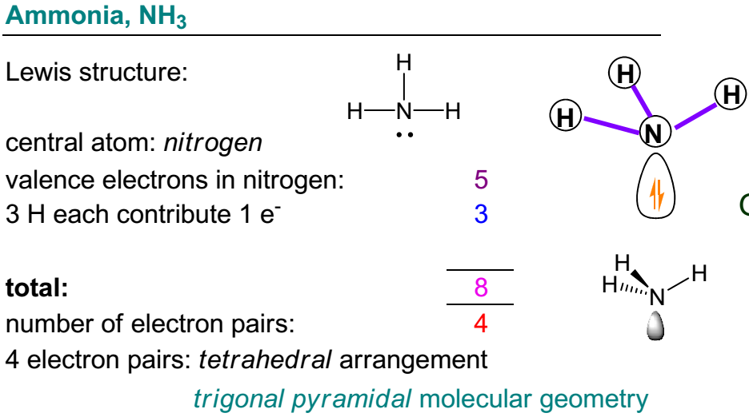
VSEPR Theory: Examples

Slide 23
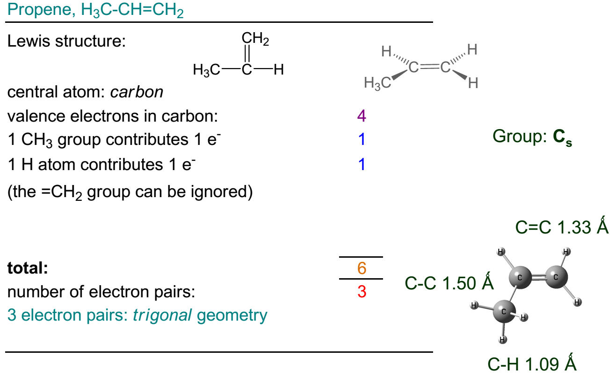
VSEPR Theory: Examples

Slide 24
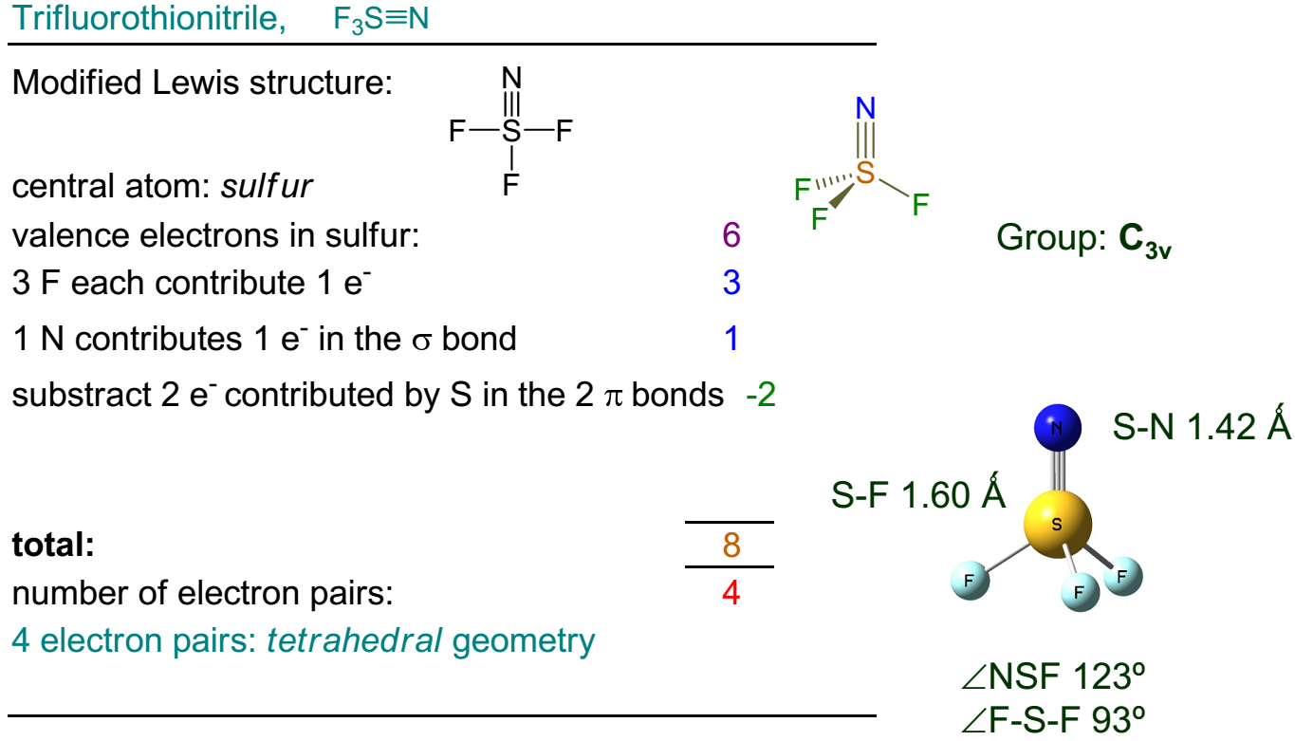
VSEPR Theory: Examples

Slide 25
VSEPR Theory: Examples

Slide 26
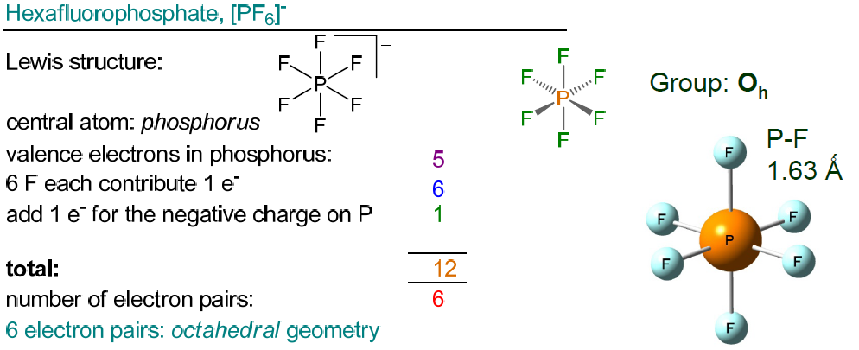
VSEPR Theory: Examples

Slide 27
VSEPR Theory: Limitations
This approach is time-consuming, because it requires handling all valence electrons.
It is easy to make simple arithmetic mistakes when you work with large numbers.
The number of electrons around the central atom in a molecule can often be ≠ 8 (e.g. 6, 10, 12), that can be confusing and make you feel unsure.
Accurate Lewis structures can be difficult to draw for many compounds. This can complicate making the decisions about the shape.

Slide 28
Valence Bond theory and Hybrid orbitals
The valence bond theory was proposed by Heitler and London to explain the formation of covalent bond quantitatively using quantum mechanics.
Later on, in the 1930s, Linus Pauling improved this theory by introducing the concept of hybridization.
According to VBT, covalent bonds are formed between the two atoms by the overlap of half filled valence atomic orbitals of each atom containing one unpaired electron.
In the VBT approach, the electron density associated with a bond is the result of an overlap between appropriately oriented atomic orbitals.

Slide 29
Hybridization and Hybrid orbitals
The intermixing of two or more pure atomic orbitals of an atom with almost same energy to give same number of identical and degenerate new type of orbitals-hybridization.
The new orbitals formed are also known as hybrid orbitals.
Two types of covalent bonds are formed based on the pattern of overlapping orbitals.
(i) σ-bond: The covalent bond formed due to overlapping of atomic orbital along the internuclear axis.
It is a stronger bond and cylindrically symmetrical.

Slide 30
Hybridization and Hybrid orbitals
Depending on the types of orbitals overlapping, the σ-bond is divided into following types:

Slide 31
Hybridization and Hybrid orbitals

Slide 32
Hybridization and Hybrid orbitals
(ii) π-bond: The covalent bond formed by sidewise overlapping of atomic orbitals.
In this bond, the electron density is present above and below the internuclear axis.
It is relatively a weaker bond since the electrons are not strongly attracted by the nuclei of bonding atoms.

Slide 33
Types of Hybridization
During hybridization, the atomic orbitals with different characteristics are mixed with each other.
Hence there is no meaning of hybridization between same types of orbitals i.e.
mixing of two 's' orbitals or two 'p' orbitals is not called hybridization.
However, orbital of 's' type can mix with the orbitals of 'p' type or 'd' type.
Based on the type and number of orbitals, the hybridization can be subdivided into following types.
sp, sp²,sp³,sp³d, sp³d²,sp³d³ etc…

Slide 34
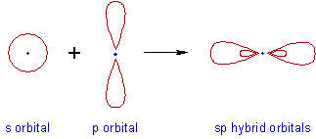
Types of Hybridization
sp Hybridization- Intermixing of one 's' and one 'p' orbitals of almost equal energy to give two identical and degenerate hybrid orbitals.
These sp-hybrid orbitals are arranged linearly at 180º of angle. They possess 50% 's' and 50% 'p' character.
E.g., BeCl₂; Be is the central atom in this compound and normally Be has 4 atomic number, then its electronic configuration is 1s², 2s².

Slide 35
sp Hybridization
Thus, Be contains 2e⁻s at the ground state before bonding in 2s orbital. But at the exited state (during reaction) one electron promotes to the empty 2p orbital in order to share these two electrons with two chlorines.

Slide 36
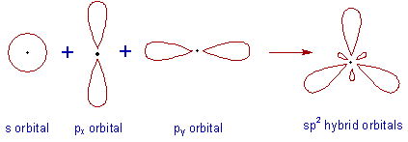
sp² Hybridization
sp² Hybridization- Intermixing of one 's' and two 'p' orbitals of almost equal energy to give three identical and degenerate hybrid orbitals.
The three sp² hybrid orbitals are oriented in trigonal planar symmetry at angles of 120º to each other. The sp² hybrid orbitals have 33.3% 's' character and 66.6% 'p' character.

Slide 37
sp² Hybridization
E.g., BCl₃,

Slide 38
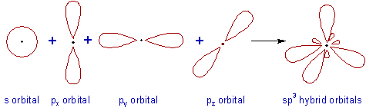
sp³ Hybridization
In sp³ hybridization, one 's' and three 'p' orbitals of almost equal energy intermix to give four identical and degenerate hybrid orbitals.
These four sp³ hybrid orbitals are oriented in tetrahedral symmetry with 109º28' angle with each other.
The sp³ hybrid orbitals have 25% 's' character and 75% 'p' character.

Slide 39
sp³ Hybridization
E.g., CH₄

Slide 40
Molecular Orbital Theory (MOT)
MOT was developed by Robert S. Mullikan, incorporates the wave like characteristics of electrons in describing bonding behavior.
In MOT, the bonding between atoms is described as a combination of their atomic orbitals.
The electrons are delocalized since they are not assigned to a particular atom or bond.
MOT allows one to predict the distribution of electrons in a molecule which in turn can help to predict molecular properties such as shape, magnetism, and Bond Order.
Bonding and Antibonding Molecular Orbitals (MOs)
BMO– MOs with electron density concentrated in the regions between atoms.
Bonding MOs have lower energy and greater stability than the atomic orbitals from which it was formed.

Slide 41
MOT
Antibonding Molecular Orbital – MOs with electron density concentrated in regions other than between the atoms.
Anitbonding MOs have higher energy and lower stability than the atomic orbitals from which it was formed.
If the atomic orbitals have different phases, they interfere destructively and an antibonding molecular orbital is formed.

Slide 42
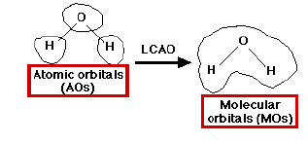
Linear Combination of Atomic Orbitals (LCAO)
LCAO, is a quantum superposition of atomic orbitals and a technique for calculating molecular orbitals in quantum chemistry.
This supposes that we can construct molecular orbitals from linear superposition of atomic orbitals centered on individual atoms.
It can be expressed as; ψ₊= c_{a+}ψ_{a}+ c_{b+}ψ_{b} or ψ₋= c_{a-}ψ_{a}-c_{b-}ψ_{b}
where ψ is the molecular wave function, ψ_{a} and ψ_{b} are atomic wave functions, and c_{a}, and c_{b} are adjustable mixing coefficients.
The coefficients can be equal or unequal, positive or negative, depending on the individual orbitals and their energies.

Slide 43
LCAO
Three conditions are essential for overlap to lead to bonding.
1. The symmetry of the orbitals must be such that regions with the same sign of + overlap.
2. The energies of the atomic orbitals must be similar.
3. The distance between the atoms must be short enough to provide good overlap of the orbitals
Types of Bonds in Molecular orbital
Sigma Bonds- Molecular orbitals that are symmetrical about the axis of the bond are called sigma molecular orbitals, often abbreviated by the Greek letter σ.
There are two types of sigma orbitals formed, bonding sigma orbitals (σ) and antibonding sigma orbitals (σ*).
σs, σ*s, σ2p, σ*2p

Slide 44
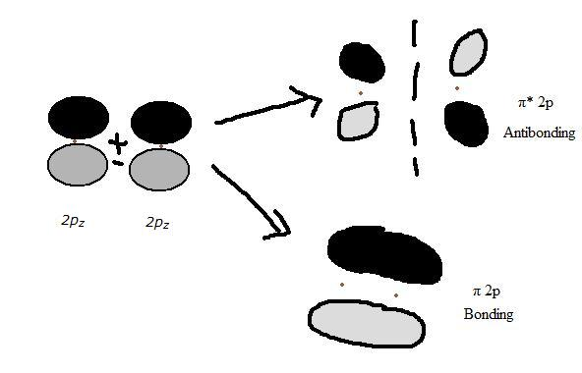
Types of Bonds in Molecular orbital
Pi Bonds- the covalent bond formed by sidewise overlapping of atomic orbitals.
In this bond, the electron density is present above and below the internuclear axis.
In the pi bonding, there are an overlap of atomic orbitals in between p_{y}-p_{y} and p_{z}-p_{z} orbitals to form π_{2py}, π_{2pz} bonding and π*_{2py}, π*_{2pz} antibonding molecular orbitals.

Slide 45
Determining Bond Order
Bond Order indicates the strength of the bond, the higher the Bond Order the stronger the bond.
Bond order can be calculated as follows:
E.g, H₂, BO =½ (2 –0) = 1 H–H single bond will be formed.
Bond order determines the stability of the molecule.
Bond order | Type of bond and stability | Example
0 | No bond & not stable, | He₂
1 | Single bond, stable | H₂
2 | Double bond, more stable | O₂
3 | Triple bond, very stable | N₂
MOT can more accurately describe partial bonds (for example in H₂⁺, where the Bond Order =1/2)

Slide 46
Rules of MOT
MO Theory has five basic rules
1. The number of molecular orbitals = the number of atomic orbitals combined.
2. Of the two MO's, one is a bonding orbital (lower energy) and one is an anti-bonding orbital (higher energy).
3. Electrons enter the lowest orbital available.
4. The maximum # of electrons in an orbital is 2 (Pauli Exclusion Principle).
5. Electrons spread out before pairing up (Hund's Rule).

Slide 47
Drawing Molecular Orbital Diagrams
Determine the number of electrons in the molecule.
Fill the molecular orbitals from bottom to top until all the electrons are added.
Describe the electrons with arrows.
Put two arrows in each molecular orbital, with the first arrow pointing up and the second pointing down.
Orbitals of equal energy are half filled with parallel spin before they begin to pair up.

Slide 48
MO Energy level Diagram for Homonuclear and Heteronuclear Diatomic Molecules
The molecular electronic configuration of molecules is determined using spectroscopic data.
For period 2 diatomic molecules up to and including N₂ the electronic configuration is: σ_{2s}, σ*_{2s}, π_{2p}, σ_{2p}, π*_{2p}, σ*2p.
For period 2 diatomic molecules O₂, F₂, and Ne₂: π_{2p} and σ_{2p} change order and the electronic configuration is: σ_{2s}, σ*_{2s}, σ_{2p}, π_{2p}, π*_{2p}, σ*_{2p}

Slide 49
MO Energy level Diagram
In heteronuclear diatomic molecules, mixing of atomic orbitals only occurs when the electronegativity values are similar.
In heteronuclear diatomic molecules,
The more electronegative element makes a greater contribution to the bonding MO’s, and
The less electronegative one makes a greater contribution to the antibonding MO’s.
The bonding MO’s have energies similar to those of the contributing AO’s of the more electronegative atom.
The antibonding MOs have energies close to those of the contributing AO’s of the less electronegative atom.

Slide 50
Examples
Molecule | Energy level Diagram
He₂, Electron Configuration of He atom is: He: 1s² ,Electrons found in He₂ are: He + He = 2 + 2 = 4 Molecular orbital configuration for He₂: (σ1s)²(σ*1s)², Bond order for He₂: BO = ½ (2 – 2) = 0, Therefore, He₂ does not exist.
He₂⁺, Electron Configuration of He atom is: 1s² ,Electrons found in He₂⁺ are: He⁺ + He = 1 + 2 = 3 Molecular orbital configuration for He₂⁺: (σ1s)²(σ*1s)¹, Bond order for He₂⁺: BO = ½ (2 –1) = 1/2, Therefore the bond between He--He is partial bond.

Slide 51
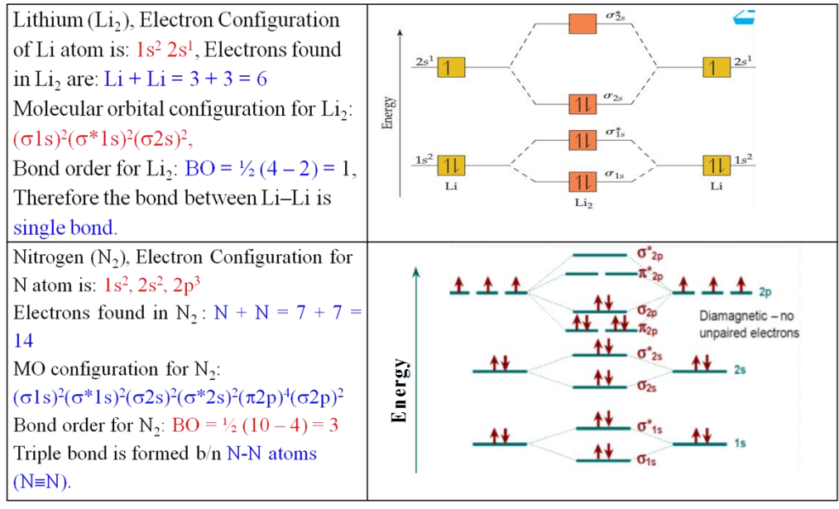
Examples

Slide 52
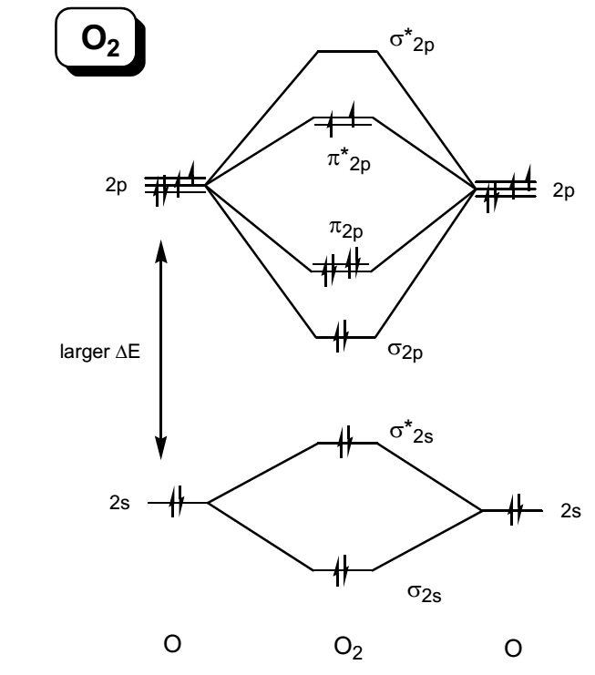
Examples
Oxygen (O₂), Electron Configuration for O atom is: 1s², 2s², 2p⁴ Electrons found in O₂ : O + O = 8 + 8 = 16 MO configuration for O₂: (σ1s)²(σ*1s)²(σ2s)²(σ*2s)² (σ2p_{x})²(π2p_{y}² π2p_{z}² ) (π*2p_{y}¹ π*2p_{z}¹) (σ*2p_{x})⁰ Bond order for O₂: BO = ½ (8 – 4) = 2 Double bond is formed b/n O-O atoms (O=O).
NO, Oxygen (NO), Electron Configuration for: N atom is: 1s², 2s², 2p³ and O atom is: 1s², 2s², 2p⁴ Electrons found in NO : N + O = 7 + 8 = 15 MO configuration for NO: (σ1s)²(σ*1s)²(σ2s)²(σ*2s)² (σ2p_{x})²(π2p_{y}² π2p_{z}² ) (π*2p_{y}¹ π*2p_{z}⁰) (σ*2p_{x})⁰ Bond order for NO: BO = ½ (6 – 1) = 2.5 Double and partial bond is formed b/n N-O atoms (N≡O).

Slide 53
Metallic Bond
It is the attraction between metal atoms in a metallic crystal.
It is formed between electropositive metal atoms of same or different elements.
The valence electrons of pure metals are not strongly associated with particular atoms due to their low ionization energy.
Electrons in metals are said to be delocalized (not found in one specific region, such as between two particular atoms). Presentation1.pptx
So the electrons act like a flowing “sea”, moving about the positively charged cores of the metal atoms. E.g., Cu, Ag, Fe etc

Slide 54
General properties of metals
General Physical Properties of the metals
The metals have a shiny appearance, they show a metallic luster
Metals are mostly harder to cut
Most metals are malleable (on being hammered they can be beaten into thinner sheets) and ductile (they can be drawn into wires)
They are good conductors of electricity and heat
Metals are generally sonorous i.e. they make a ringing sound when struck.
All metals except Mercury, exist in the solid form at room temperature.

Slide 55
General properties of metals
General Chemical Properties
When metals burned in the presence of oxygen, they combine with oxygen to form basic metallic oxides.
Different metals react differently with water:
Sodium reacts violently with water → sodium hydroxide and hydrogen
Magnesium reacts mildly with water but vigorously with steam
Most metals react with acids to produce salts and hydrogen
Most metals corrode when they are exposed to atmosphere
Metals replace other metals. E.g, Fe + CuSO₄ → Cu + FeSO₄

Slide 56
General properties of metals
General Chemical Properties
When metals burned in the presence of oxygen, they combine with oxygen to form basic metallic oxides.
Different metals react differently with water:
Sodium reacts violently with water → sodium hydroxide and hydrogen
Magnesium reacts mildly with water but vigorously with steam
Most metals react with acids to produce salts and hydrogen
Most metals corrode when they are exposed to atmosphere
Metals replace other metals. E.g, Fe + CuSO₄ → Cu + FeSO₄

Slide 57
Bonding in Metals
MB is the attraction between cations and a sea of delocalized electrons
The cations are arranged to form a lattice with the electrons
MB is illustrated by a model of cationic lattice and mobile valency electrons
In this model;
Metals are regarded as existing as ions occupying fixed positions in a crystal lattice.
The valency electrons are moving in orbitals enveloping the whole lattice.
The valency electrons are delocalized through the lattice and attract the positive ions electrostatically, thereby, holding the lattice together

Slide 58
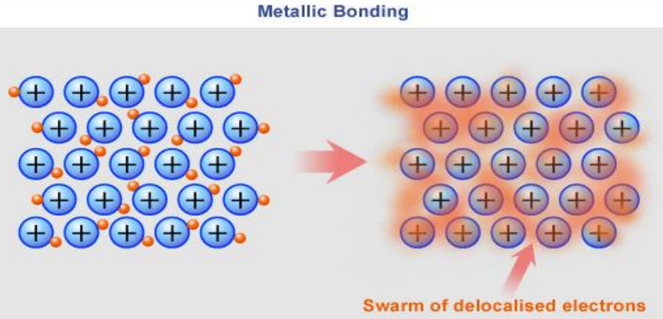
Bonding in Metals
According to the model of the metal 1attice:
positive ions of the metal are packed in a regular array within a “sea of electrons”
The electrons are delocalized throughout the lattice producing a mobile electrons cloud.
These attractive forces exactly balance the repulsion between the like-charged cations. This constitutes the metallic bond.

Slide 59

The End.

Slide 60
Assignments: Presentation
Hydrated ions of Alkali Metals (G-1)
Flame tests and Radioactive isotopes of Alkali and alkaline earth metals (G-2)
Alkaline earth metal Salts of oxoacids (G-3)
Chemistry of nitrogen group elements: occurrence, reactivity and extraction (G-4)
Chemistry of oxygen group elements: occurrence, reactivity and extraction (G-5)
Chemistry of Halogen group elements: occurrence, reactivity and extraction (G-6)
Chemistry of Noble gases: occurrence, reactivity and extraction (G-7)

